Slide 1
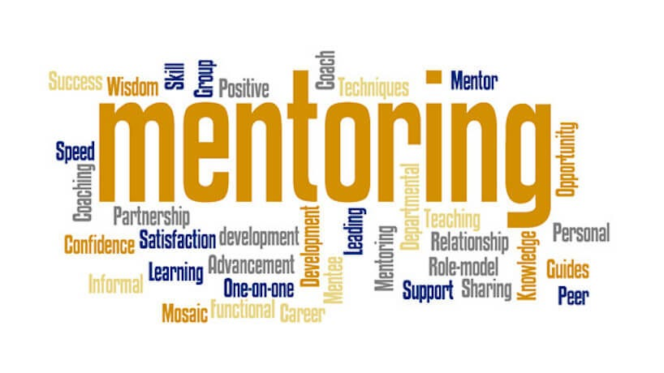
International Conference SHARING AND LEARNING FOR MENTORING IN EDUCATION ICSLME - SIBIU, 2023
New perspectives on the mentoring system in European teacher career
Between transitions’ challenges and the new flexibles continuous learning and training pathways
Prof. Romiță Iucu, Ph.D.
University of Bucharest

Slide 2
Content
01
General background
02
Political fascination
04
03
Structural and functional design
Transformative approach
05
Reflections and conclusions

Slide 3
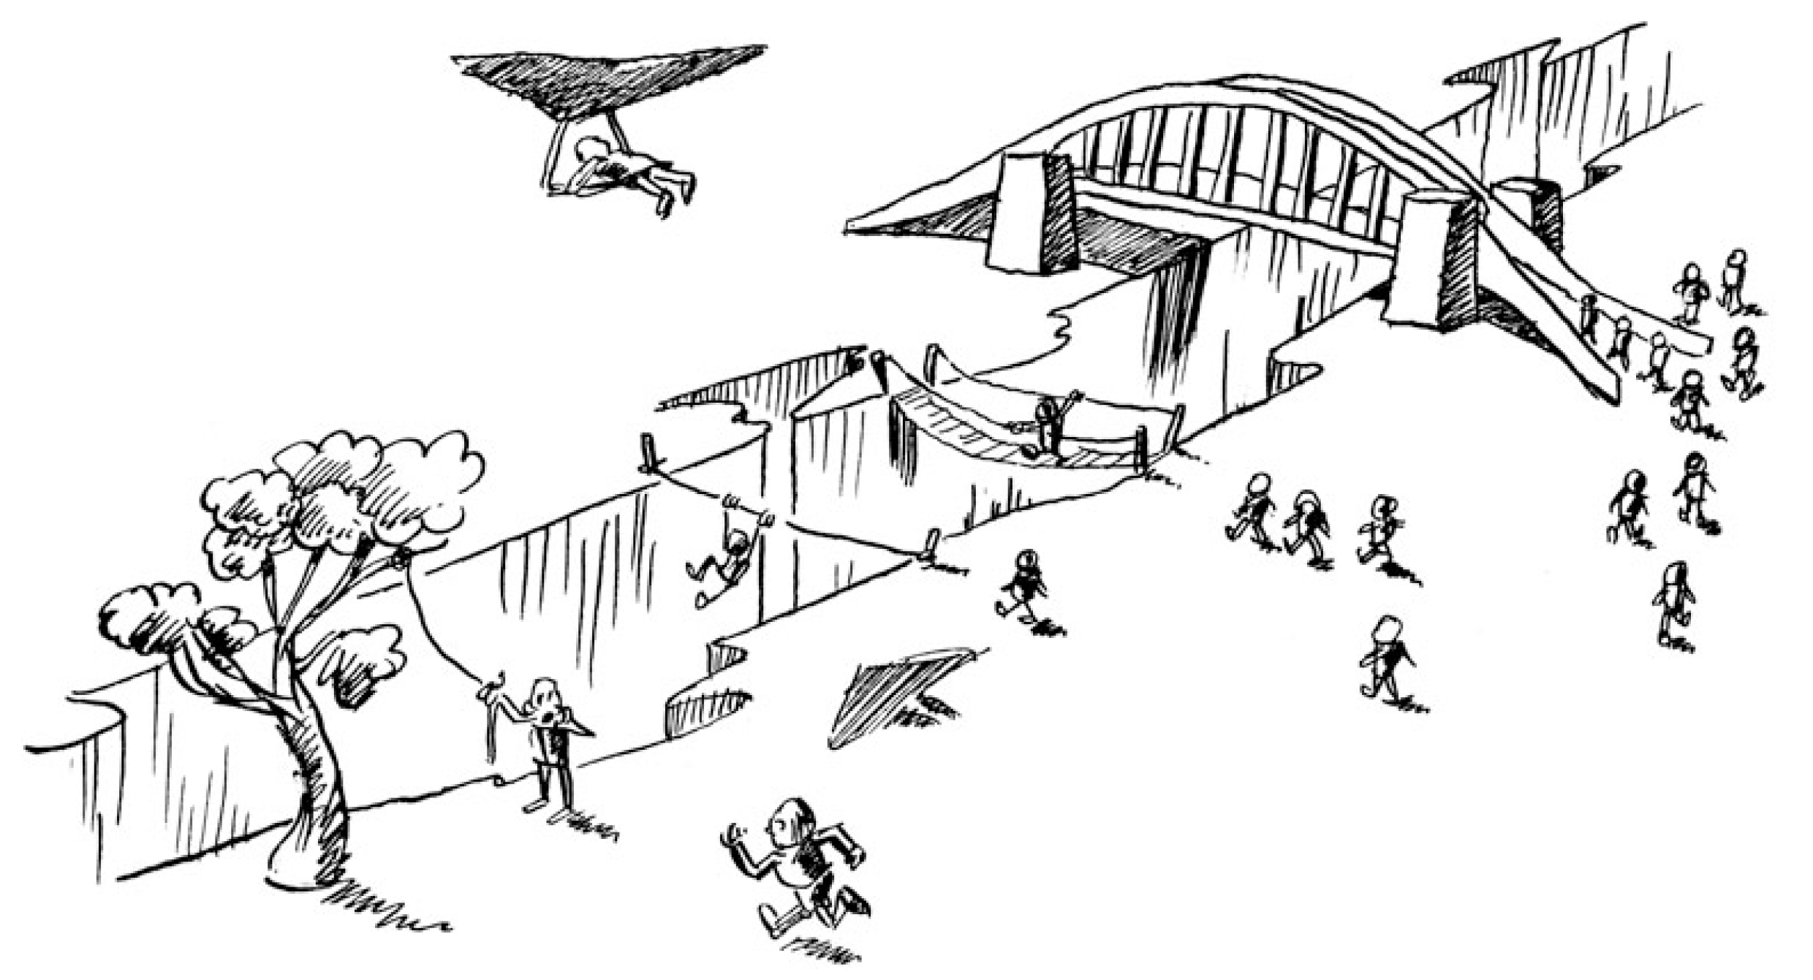
Between transitions’ challenges and the new flexibles continuous learning and training pathways
@(Educational Transitions and Change (ETC) Research Group, 2011)

Slide 4
01
General Background
Between transitions’ challenges and the new flexibles continuous learning and training pathways

Slide 5
UNESCO, 2021

Slide 6
Reimagining our future together -
a new social contract for education
This transition phase between preparation and professional practice is the most decisive in the teaching professional life and yet it is often neglected, both by policies and by the profession itself, and, as a result, it faces the highest rates of attrition.
In any profession, there is nothing more important than how new generations of teachers are welcomed and socialized. Induction programmes should support novice teachers throughout their vital first years with collaborative structures to plan lessons and mentoring from more experienced colleagues.
UNESCO, 2021

Slide 7
Reimagining our future together -
a new social contract for education
The best of these practices prioritize mentorship and ensure the socialization of young teachers by providing an adequate transition between periods of professional development and professional practice – all of which require strong collaboration on the part of universities and teachers’ colleges.
Ongoing contact between teachers and universities can contribute greatly to the improvement of schools and processes of educational transformation.
UNESCO, 2021

Slide 8
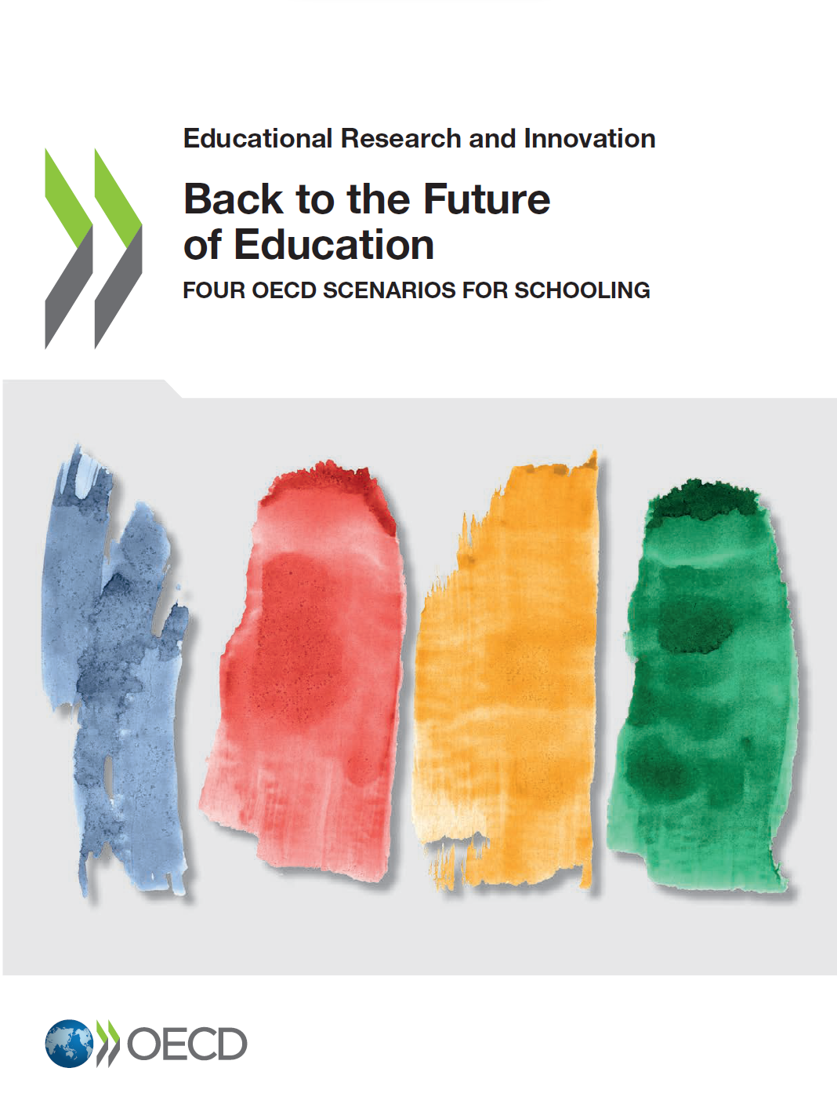
OECD, 2020

Slide 9
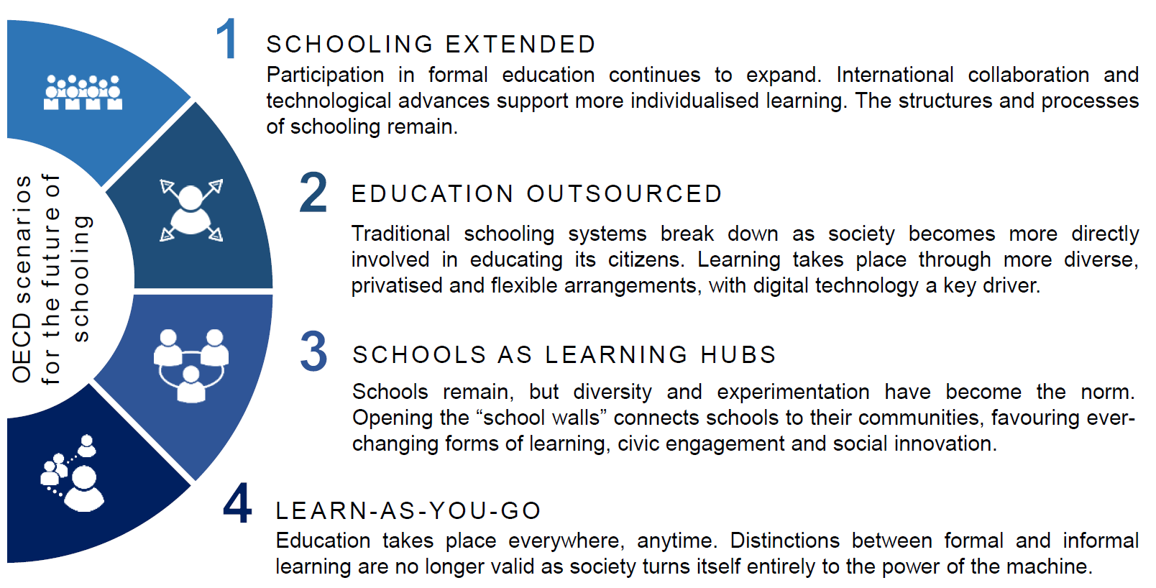
Back to the future of education, OECD
OECD, 2020

Slide 10
02
Political Fascination
Between transitions’ challenges and the new flexibles continuous learning and training pathways

Slide 11
Sorbonne 2017 – E. Macron “Initiative for Europe”

Slide 12
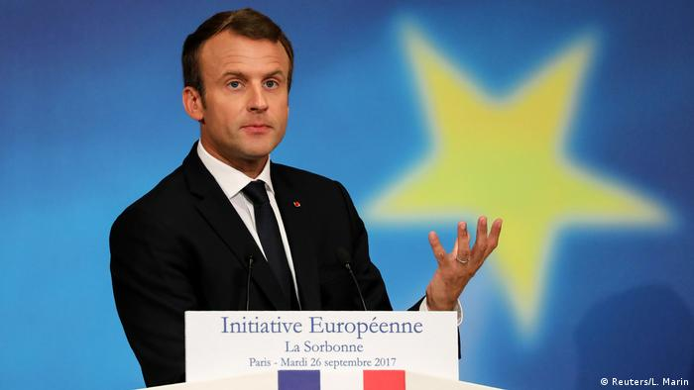
Initiative Europeenne... Initiative for Europe
PARIS - SORBONNE, 2017

Slide 13
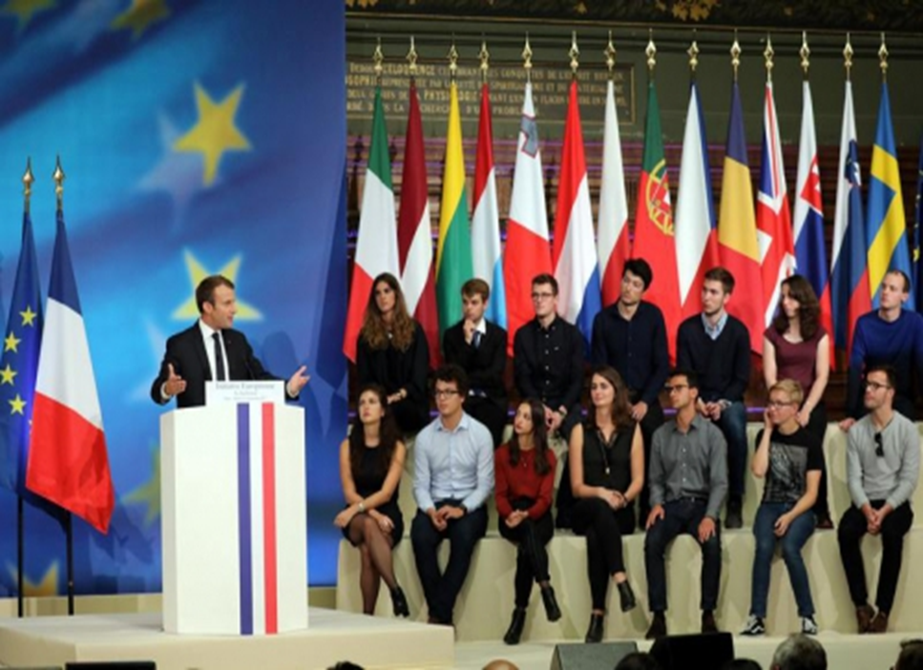
Initiative Europeenne... Initiative for Europe
The background for launching an extended discussion with global significance regarding the European Universities/European Alliances
Impact on the institutional practices and values shared by the main stakeholders involved in the design of the future European Education Area
“In this place (...) believed in the power of learning, critical thinking, and culture (…)”.
Making learning a reality for all!
PARIS - SORBONNE, 2017

Slide 14
Next political steps ...
November 2017
December 2017
“Making learning mobility a reality for all”
Gothenburg Summit
European Council
European Commission, 2017

Slide 15
EHEA Conference - Paris, 2018
As high quality teaching is essential in fostering high quality education, academic career progression should be built on successful research and quality teaching.
We will promote and support institutional, national and European initiatives for pedagogical training, mentoring, continuous professional development of higher education teachers and explore ways for better recognition of high quality and innovative teaching in their career.”
EHEA, 2018

Slide 16
Rome Ministerial Communique, 2020
Flexible and open learning paths (...) are important aspects of student-centred learning and are in increasing demand in our societies. In addition to full degree programs, many higher education institutions offer or plan to offer smaller units of learning, which enable learners to develop or update their transversal skills and competences at various stages in their lives.
EHEA, 2020

Slide 17
Universities without walls, 2021
A new vision for the future... Higher education institutions (with all component included) without walls ...
EUA, 2021
EUA, 2021

Slide 18
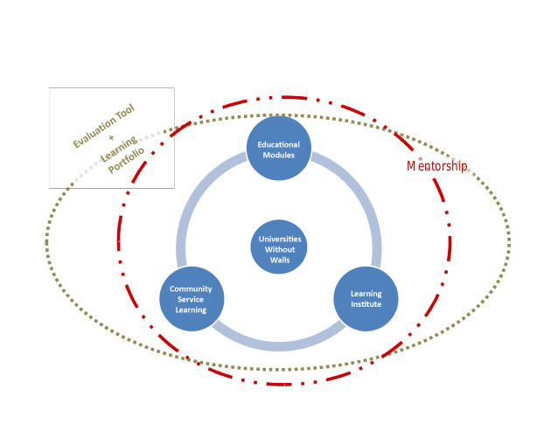
Curriculum without walls...
Curriculum without walls
Institutions without walls ...
IBANEZ CARRASCO, 2010)

Slide 19
Rome Communique, 2020
„We ask the BFUG to explore how and to what extent these smaller, flexible units, including those leading to micro-credentials, can be defined, developed, implemented and recognised by our institutions.”
Define
Develop
Implement
Recognise
EHEA, 2020

Slide 20
03
Structural and Functional Design
Between transitions’ challenges and the new flexibles continuous learning and training pathways

Slide 21
Micro-credentials, 2021
European approach to micro-credentials
European Commission, 2021
A micro-credential is a recognized proof of the learning outcomes that a learner has achieved following a short learning experience, according to transparent standards and requirements and upon assessment.
European Commission, 2021

Slide 22
Credentials, UNESCO 2022
Credentials verify, validate, confirm, or corroborate a person’s learning achievements, knowledge and preparedness for performing tasks. Credentials are diverse with regard to their scope, status and purpose
UNESCO, 2022

Slide 23
Macro-Credentials, UNESCO 2022
Generally, these include degrees, diplomas, certificates and licences, often awarded by accredited, recognized or regulated educational and other institutions /organizations. They indicate learning achievement of a broad body of knowledge, transferable skills or technical proficiency and may take a number of years to complete.
UNESCO, 2022

Slide 24
Micro-Credentials, UNESCO 2022
These are typically focused on a specific set of learning outcomes in a narrow field of learning and achieved over a shorter period of time. Micro-credentials are offered by commercial entities, private providers and professional bodies, traditional education and training providers, community organizations and other types of organizations.
UNESCO, 2022

Slide 25
Micro-credentials, 2023
PROOF
LEARNING OUTCOMES
SHORT
ASSESS / ASSESSMENT
01
02
Learning outcomes
Proof
Role of the credential
Evidence proved by the credential
03
04
Short
Assess / assessment
Duration of the learning activity
Attest solidity of the contained outcomes, competencies, or skills
Cartis et al., 2023

Slide 26
Micro-credentials: variations of the concept
“Tokens”
“Certifications of mastery of specific skills”
(Grech & Camilleri, 2017)
(Hotaling & Van Sumeren, 2022)
“Representation of an accomplishment”
“Education playlist”
(Gibson et al., 2015)
(Jones-Schenk, 2018)
“Portable currency for professional learning”
“Educational awards”
(Berry et al., 2016)
(Wheelahan & Moodie, 2021)
“Micro competencies”
“Educational-credits”
(Song, 2019)
(Mugayitoglu et al., 2021)
“Industry-aligned short units of learning”
(Wheelahan & Moodie, 2021)
Cartis et al., 2023

Slide 27
Micro-credentials – components
Micro-credential
Certification
Recognition
Learning Outcomes
Personal & Societal Needs
QF-EHEA / NQF Level
ECTS
Quality Assurance
European Commission, 2021

Slide 28
Micro-credentials and mentorship
Embedding new philosophy of micro-credentials applied in mentorship curriculum design process by piloting this type of new educational developments (such as the transdisciplinary micro-programmes, flexible programmes), building a new mentorship programs structure for designing joint small units of learning and practicing in teaching career
Sibiu, 2023

Slide 29
Structural and multidimensional approach
MODULAR DESIGN
(how do we assure stackability and interconnection?)
TRANSDISCIPLINARITY
(soft skills vs. hard skills: what do employers want?)
ECTS CREDIT POINTS
(how many are too many and what is a minimum?)
FLEXIBLE PATHWAYS
(who is leading the flexibility and what are the limits?)
MULTIPLE FORMATS
(how many and who has a say in the limits?)
MOBILITY VARIETY
(is online learning a virtual mobility or not?)
INNOVATIVE PEDAGOGIES
(can we talk about innovation guidelines in education?)
RECOGNITION & CERTIFICATION
(do trust and accountability pass national barriers?)
INTER-INSTITUTIONAL COOPERATION
(how do we define a successful cooperation?)
STRUCTURAL, SYSTEMIC, SUSTAINABLE IMPACT
(can we design a model for assessing the impact?)
Modular design
Trans-disciplinarity
ECTS credit points
Flexible pathways
Multiple formats
Mobility variety
Innovative pedagogies
Recognition & Certification
Inter-institutional cooperation
Structural, systemic, sustainable impact
Iucu & Cartis, 2022

Slide 30
04
Transformative Approach
Between transitions’ challenges and the new flexibles continuous learning and training pathways

Slide 31
Transitions... Between continuities and discontinuities
Bachelor (EQF6)
+
Psycho-pedagogical Module I
Master (EQF7)
+
Psycho-pedagogical Module II
School
Mentor
Transition 4:
What should I do?
University
Bachelor (EQF6)
Didactic Master (EQF7)
Continous training
Transition 1:
Which way?
Transition 2:
Is this what I want?
Transition 3:
Was it worth it?
Transition 5:
Why?

Slide 32
Five transitions...
5. Classroom – Continuous training
4. Classroom – Mentorship
Updating personal and professional profile with continuous training pathways linked with teachers’ specific needs
Identifying associate risks (financial, psycho-emotional, familial, etc.) that can negatively impact the teacher’s participation to continuous training
Ensure a high relevance level of the training portfolio, according to the professional needs and the realities “at ground level”
Identify the suitable mentor(s), based on the teacher’s personal and professional profile
Create support and cooperation groups at school and field of study levels
Solve crisis moments at school level and among teachers
04
05
3. University – Classroom
Support in identifying a school, based on competencies and personal and professional profile
Anticipate and provide solutions for risk factors (financial, social, familial, vocational, etc.)
Build an individualized professional profile, with development stages, based on needs and expectations
1. Secondary education – University
03
01
Need for career counseling and guidance towards teaching careers
Get familiar with the “job” and connected professional opportunities
Reduce fake information impact and misconceptions
02
2. Bachelor – Master
Anticipate and prevent dropouts among students
Align training on transparent and clear goals
Support, empathize, guide, council students
Sibiu, 2023

Slide 33
New EMCC Global definition of Mentoring, 2023
New mentoring definition:
„Is a learning relationship, involving the sharing of skills, knowledge and expertise, between a mentor and mentee through developmental conversation, experience sharing, and role modelling.
The relationship may cover a wide variety of context, and is an inclusive two-way partnership for mutual learning that value differences.”
Kucin, 2023

Slide 34
Innovative ways for transforming mentoring
Transformative perspective it goes from a one-for-all model, towards agile, flexible, personalized learning opportunities, using:
Mentoring and the role of key levers for achieving real transformations and building up new fully recognizable and portable learning pathways models
(Council of the European Union, 2021)

Slide 35
Innovative ways for transforming mentoring
Various innovative components, such as micro-credentials,
Digitally enhanced - parts of them embedded in the curricula,
Learning portability and digital credentials,
Flexible curricula and modularization of learning,
Innovative pedagogies
Relevance and authenticity
(Council of the European Union, 2021)

Slide 36
Transformative perspective of
the European mentorship
Flexible curricula and modularization
of learning
Learning portability
and digital
credentials
Micro-credentials
Innovative
pedagogies
Relevance and
authenticity
Embedded and
Digitally
enhanced mobility

Slide 37
Innovative pedagogies as new ways for
transforming mentoring
Innovative
pedagogies
Pedagogy is the work of creating transformational encounters that are based in what exists and what can be built.
UNESCO, 2021

Slide 38
Innovative trajectories as new ways for
transforming mentoring
Future policy agendas will need to embrace all levels of education and better account for non-traditional educational trajectories and pathways.
Recognizing the interconnectedness of different levels and types of education, speaks to the need for a sector-wide, lifelong learning approach towards the future development of teacher education.
UNESCO, 2021

Slide 39
05
Reflections and conclusions
Between transitions’ challenges and the new flexibles continuous learning and training pathways

Slide 40
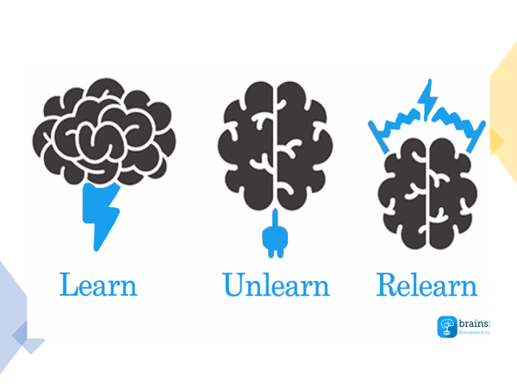
Learn to Unlearn...
Beginning the unlearning... in order to start transformation
Vasinis, 2020

Slide 41
New perspective on transforming mentoring
A new mentorship programme should be built in a transformative way, which includes innovative pedagogies and offer highly motivational learning experiences for our students and young professionals, through flexibility, embedded diverse mobility, relevance, and authenticity.
The entire philosophy of building the future shape will be based on micro-credentials applied to teacher education
Sibiu, 2023

Slide 42
Future reflections ...
How will the idea of mentoring without walls will be applied, what will be the systemic, institutional, personal consequences ?
Are the staff, including the leadership/governance, aware and prepared for all the mentoring challenges presented above, especially the management of the transitions ?
Are the national and institutional decision-makers aware of any change, ex. flexibilisation pathways, micro-credentials in the mentorship process ?
How the benefits of European public policies aplied in this area will be exploited for ensuring the continuities in TE
Sibiu, 2023

Slide 43
Between transitions’ challenges and the new flexibles continuous learning and training pathways
Relevance and authenticity
Micro-credentials
Embedded mobility
Innovative pedagogies
Flexible curricula
Learning portability
@(Educational Transitions and Change (ETC) Research Group, 2011)

Slide 44
International Conference SHARING AND LEARNING FOR MENTORING IN EDUCATION ICSLME - SIBIU, 2023
Thank you very much
for your attention !
Va multumesc pentru atentie !
Prof. Romiță Iucu, Ph.D.
University of Bucharest

Slide 45
References
Carrasco, I. (2010). Universities without walls [PowerPoint]. https://www.slideshare.net/CriticalJunctures/ibanez-carrasco-universities-without-walls
Carțiș, A., Leoste, J., Iucu, R., Kikkas, K., Tammemäe, K., Männik, K. (2023). Conceptualising Micro-credentials in the Higher Education Research Landscape. A Literature Review. In M. Dascalu, P. Marti, & F. Pozzi (Eds.), Polyphonic Construction of Smart Learning Ecosystems. SLERD2022. Smart Innovation, Systems and Technologies, vol.908 (pp.191-203). Springer. https://doi.org/10.1007/978-981-19-5240-1_13
Crop, H. (2017). Sorbonne speech of Emmanuel Macron - Full text / English version. Ouest france. https://international.blogs.ouest-france.fr/archive/2017/09/29/macron-sorbonne-verbatim-europe-18583.html
Educational Transitions and Change (ETC) Research Group. (2011). Transition to school: Position statement. Albury-Wodonga: Research Institute for Professional Practice, Learning and Education, Charles Sturt University
EHEA. (2020). Rome Ministerial Communiqué. http://www.ehea.info/Upload/Rome_Ministerial_Communique.pdf
EHEA. (2018). Paris Communiqué. https://www.ehea.info/Upload/document/ministerial_declarations/EHEAParis2018_Communique_final_952771.pdf
EUA. (2021). Universities without walls: A vision for 2030. European University Association. https://eua.eu/resources/publications/957:universities-without-walls-%E2%80%93-eua%E2%80%99s-vision-for-europe%E2%80%99s-universities-in-2030.htm
European Commission. (2021). A European approach to micro-credentials. Output of the Micro-credentials Higher Education Consultation Group: Final Report. Publications Office. https://doi.org/10.2766/30863
International Commission on the Futures of Education. (2021). Reimagining our futures together: a new social contract for education. UNESCO. https://doi.org/10.54675/ASRB4722
Iucu, R., & Cartis, A. (2022). CIVIS Micro-credentials & micro-programmes [PowerPoint]. https://www.slideshare.net/AlexandruMihaiCari/civis-microcredentials-microprogrammes-r-iucu-a-cartis-2022
Kucin, S. (2023). How can mentoring be helpful to me? New EMCC Global definition of Mentoring. Mentoring Culture. https://mentoring-culture.com/how-can-mentoring-be-helpful-to-me/
OECD. (2020). Back to the Future of Education: Four OECD Scenarios for Schooling, Educational Research and Innovation. OECD Publishing. https://doi.org/10.1787/178ef527-en
UNESCO. (2022). Towards a common definition of micro-credentials. UNESCO. https://unesdoc.unesco.org/ark:/48223/pf0000381668
Vasinis, A. (2020). 5 Ways to Make Learning, Unlearning & Relearning a part of your life. Medium. https://medium.com/brainsfeed/5-ways-to-make-learning-unlearning-relearning-a-part-of-your-life-e15a111441d3

